Slide 1
Review: Benchmark: The Naive Rule
The naive rule is used mainly as a baseline or benchmark for evaluating the performance of more complicated classifiers.
A very simple rule for classifying a record into one of m classes, ignoring all predictor information that we may have, is to classify the record as a member of the majority class. In other words, “classify as belonging to the most prevalent class.”
Similar to using the sample mean (y) as the naive benchmark in the numerical outcome case, the naive rule for classification relies solely on the y information and excludes any additional predictor information.

Slide 2
Class Separation
If the classes are well separated by the predictor information, even a small dataset will suffice in finding a good classifier, whereas if the classes are not separated at all by the predictors, even a very large dataset will not help.

Slide 3
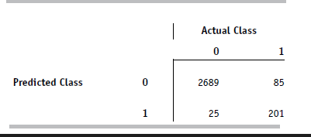
Confusion Matrix
In practice, most accuracy measures are derived from the confusion matrix, also called classification matrix. This matrix summarizes the correct and incorrect classifications that a classifier produced for a certain dataset. Rows and columns of the confusion matrix correspond to the predicted and true (actual) classes, respectively.

Slide 4
Using the Validation Data
To obtain an honest estimate of future classification error, we use the confusion matrix that is computed from the validation data.
In other words, we first partition the data into training and validation sets by random selection of records. We then construct a classifier using the training data, and then apply it to the validation data.
We then summarize these classifications in a confusion matrix.
Although we can summarize our results in a confusion matrix for training data as well, the resulting confusion matrix is not useful for getting an honest estimate of the misclassification rate for new data due to the danger of overfitting.
In addition to examining the validation data confusion matrix to assess the classification performance on new data, we compare the training data confusion matrix to the validation data confusion matrix, in order to detect overfitting

Slide 5
Accuracy Measures
Different accuracy measures can be derived from the classification matrix. Consider a two-class case with classes C1 and C2 (e.g., buyer/non-buyer).
if predicted class = actual class; these count as accurate predictions
if predicted class ≠ actual class; these count of misclassifications.
The first step in most classification algorithms is to estimate the probability that a record belongs to each of the classes.
If overall classification accuracy (involving all the classes) is of interest, the record can be assigned to the class with the highest probability.
In many records, a single class is of special interest, so we will focus on that particular class and compare the propensity of belonging to that class to a cutoff value set by the analyst.
The default cutoff value in two-class classifiers is 0.5. Thus, if the probability of a record being a class C1 member is greater than 0.5, that record is classified as a C1.
It is possible, however, to use a cutoff that is either higher or lower than 0.5.

Slide 6
KNN K-Nearest Neighbors
K nearest neighbors is a simple algorithm that stores all available cases and classifies new cases based on a similarity measure (e.g., distance functions).
Used in statistical estimation and pattern recognition since the 1970s as a non-parametric technique.

Slide 7
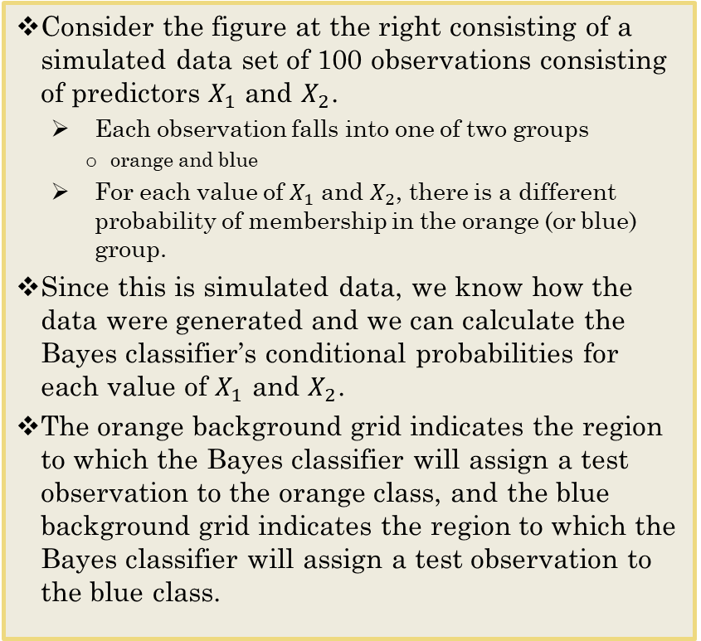
The Classification Case Bayes Classifier
Consider the figure at the right consisting of a simulated data set of 100 observations consisting of predictors $X_{1}$ and $X_{2}$.
Each observation falls into one of two groups
orange and blue
For each value of $X_{1}$ and $X_{2}$, there is a different probability of membership in the orange (or blue) group.
Since this is simulated data, we know how the data were generated and we can calculate the Bayes classifier’s conditional probabilities for each value of $X_{1}$ and $X_{2}$.
The orange background grid indicates the region to which the Bayes classifier will assign a test observation to the orange class, and the blue background grid indicates the region to which the Bayes classifier will assign a test observation to the blue class.

Slide 8
The Classification Case - Bayes Classifier
The purple dashed line is called the Bayes decision boundary.
The Bayes classifier produces the lowest possible test error rate, called the Bayes error rate.
For our simulated data, the Bayes error rate is 0.1304. It is greater than zero, because of classes overlap in the actual population.
Observe that there are some orange points in the blue region, and conversely.
The Bayes error rate is analogous to the irreducible error
discussed earlier.

Slide 9
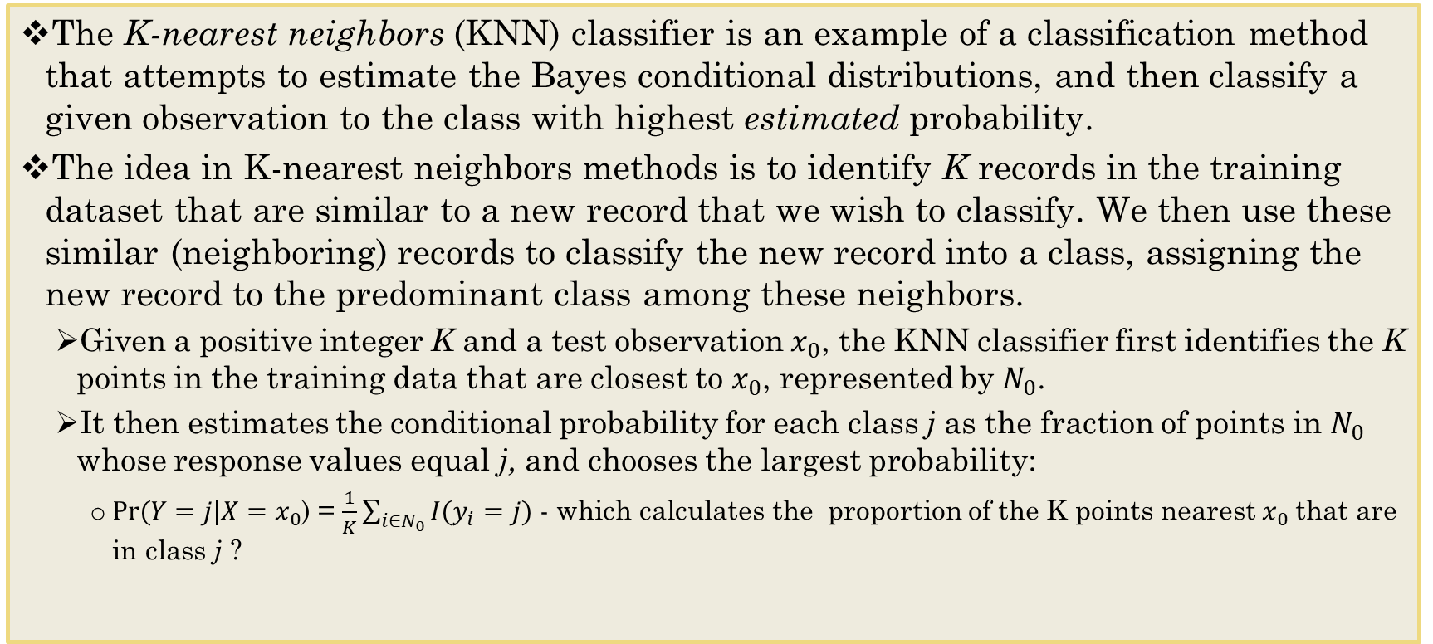
The Classification Case K-Nearest Neighbors
The K-nearest neighbors (KNN) classifier is an example of a classification method that attempts to estimate the Bayes conditional distributions, and then classify a given observation to the class with highest estimated probability.
The idea in K-nearest neighbors methods is to identify K records in the training dataset that are similar to a new record that we wish to classify. We then use these similar (neighboring) records to classify the new record into a class, assigning the new record to the predominant class among these neighbors.
Given a positive integer K and a test observation $x_{0}$, the KNN classifier first identifies the K points in the training data that are closest to $x_{0}$, represented by $N_{0}$.
It then estimates the conditional probability for each class j as the fraction of points in $N_{0}$ whose response values equal j, and chooses the largest probability:
$Pr⁡(Y=j|X=$ $x_{0}$) = $\frac{1}{K}\sum_{i∈N_{0}}{I(y_{i}=j)}$ - which calculates the proportion of the K points nearest $x_{0}$that are in class j ?

Slide 10
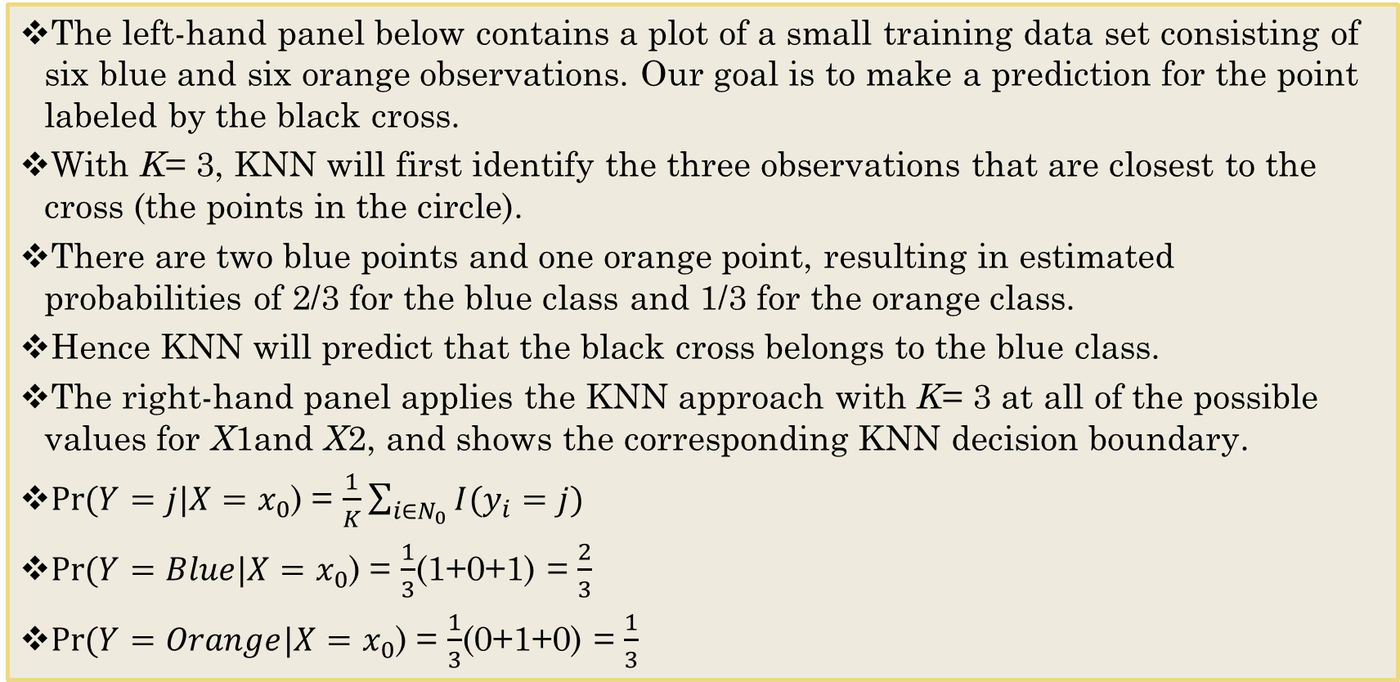
A KNN Example
The left-hand panel below contains a plot of a small training data set consisting of six blue and six orange observations. Our goal is to make a prediction for the point labeled by the black cross.
With K= 3, KNN will first identify the three observations that are closest to the cross (the points in the circle).
There are two blue points and one orange point, resulting in estimated probabilities of 2/3 for the blue class and 1/3 for the orange class.
Hence KNN will predict that the black cross belongs to the blue class.
The right-hand panel applies the KNN approach with K= 3 at all of the possible values for X1and X2, and shows the corresponding KNN decision boundary.
$Pr⁡(Y=j|X=$ $x_{0}$) = $\frac{1}{K}\sum_{i∈N_{0}}{I(y_{i}=j)}$
$Pr⁡(Y=Blue|X=$ $x_{0}$) = $\frac{1}{3}$(1+0+1) = $\frac{2}{3}$
$Pr⁡(Y=Orange|X=$ $x_{0}$) = $\frac{1}{3}$(0+1+0) = $\frac{1}{3}$

Slide 11
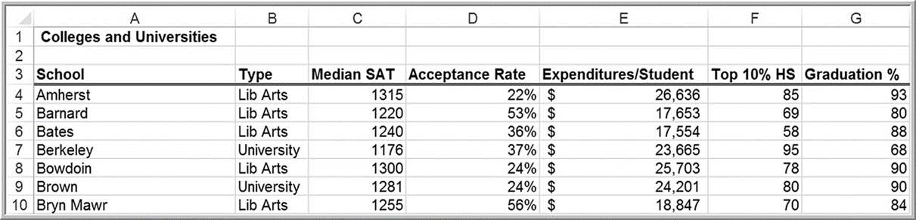
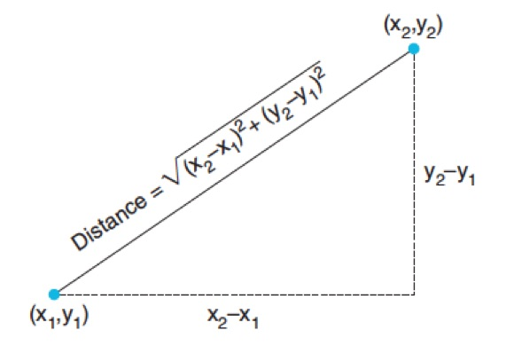
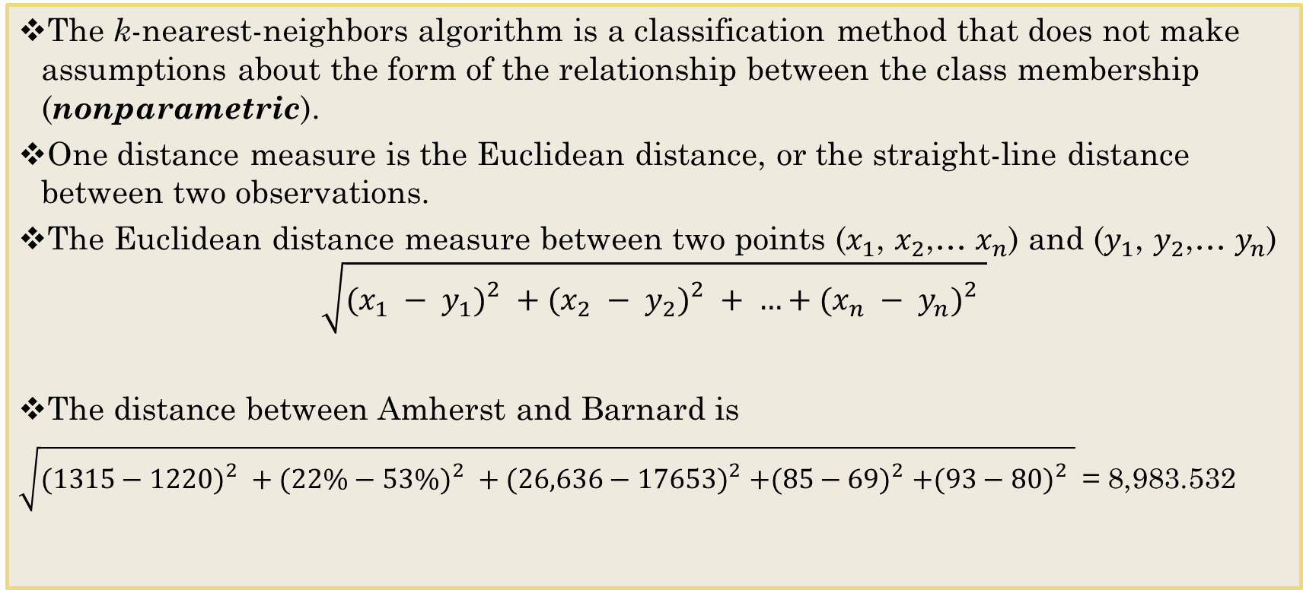
Distance Measures
Note – Centering and Scaling here Still is Important
The k-nearest-neighbors algorithm is a classification method that does not make assumptions about the form of the relationship between the class membership (nonparametric).
One distance measure is the Euclidean distance, or the straight-line distance between two observations.
The Euclidean distance measure between two points ($x_{1}$, $x_{2}$,… $x_{n}$) and ($y_{1}$, $y_{2}$,… $y_{n}$)
$$\sqrt{({x_{1} − y_{1})}_{}^{2}+({x_{2} − y_{2})}_{}^{2}+ …+{(x_{n} − y_{n})}_{}^{2}}$$
The distance between Amherst and Barnard is
$\sqrt{({1315−1220)}_{}^{2}+({22\%−53\%)}_{}^{2}+{(26,636−17653)}_{}^{2}+{(85−69)}_{}^{2}+{(93−80)}_{}^{2}}$ = 8,983.532

Slide 12
KNN and Bayes Classifier
KNN uses distance measures to help classify data.
KNN can often produce classifiers that are surprisingly close to the optimal Bayes classifier.
This figure displays the KNN decision boundary (solid line) with K = 10, when applied to the larger simulated data set from an earlier example.
Notice that even though the true distribution is not known by the KNN classifier, the KNN decision boundary is very close to that of the Bayes classifier.
The test error rate using KNN is 0.1363, which is close to the Bayes error rate of 0.1304.
Notes:
Usually pick k as odd number to avoid a tie

Slide 13
Exploring Different K’s
The choice of K, which in this case determines the flexibility of the method, has a drastic effect on the KNN classifier obtained.
The figure below displays two KNN fits to the same simulated data using K= 1 and K= 100.
When K= 1 (left pane), the decision boundary is overly flexible and finds patterns in the data that don’t correspond to the Bayes decision boundary.
This corresponds to a classifier that has low bias but very high variance.
As K grows, the method becomes less flexible, and when K=100 (right pane), produces a decision boundary that is close to linear.
This corresponds to a low-variance but very high-bias classifier.
On this simulated data set, neither K= 1 nor K= 100 give good predictions: they have test error rates of 0.1695 and 0.1925, respectively.

Slide 14
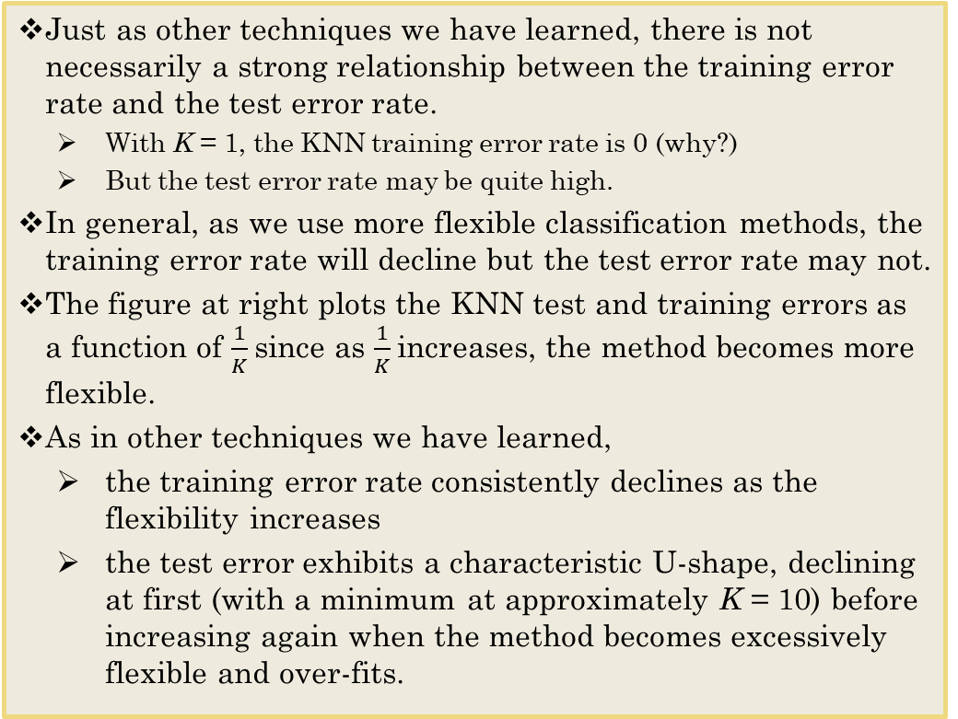
Training and Testing Error Rates in KNN
Just as other techniques we have learned, there is not necessarily a strong relationship between the training error rate and the test error rate.
With K = 1, the KNN training error rate is 0 (why?)
But the test error rate may be quite high.
In general, as we use more flexible classification methods, the training error rate will decline but the test error rate may not.
The figure at right plots the KNN test and training errors as a function of $\frac{1}{K}$since as $\frac{1}{K}$increases, the method becomes more flexible.
As in other techniques we have learned,
the training error rate consistently declines as the flexibility increases
the test error exhibits a characteristic U-shape, declining at first (with a minimum at approximately K = 10) before increasing again when the method becomes excessively flexible and over-fits.
Notes:
Black line – true error rate/bayes error rate

Slide 15
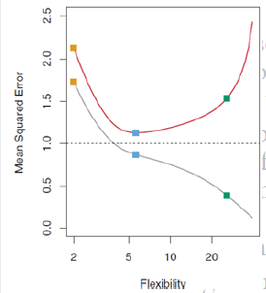
Think back to MSE
Recall the MSE in Regression Case and note the similarity.
This property of flexibility and error is a fundamental property of machine learning that holds regardless of the particular data set at hand and regardless of the statistical method being used.
In both the regression and classification settings, choosing the correct level of flexibility is critical to the success of any machine learning method.
The bias-variance tradeoff, and the resulting U-shape in the test error, can assist us in our search for the correct level of flexibility, but the presence of the (unknown) irreducible error and the limitations of sampling conspire to insure that this remains a difficult task.

Slide 16
Advantages and Shortcomings of k-NN Algorithms
The main advantage of k-NN methods is their simplicity and lack of parametric assumptions.
In the presence of a large enough training set, these methods perform surprisingly well, especially when each class is characterized by multiple combinations of predictor values.
Disadvantages of KNN
First, although no time is required to estimate parameters from the training data (as would be the case for parametric models such as regression), the time to find the nearest neighbors in a large training set can be prohibitive.
Second, the number of records required in the training set to qualify as large increases exponentially with the number of predictors p.
Third, k-NN is a “lazy learner”: the time-consuming computation is deferred to the time of prediction.

Slide 17
To Do.
Run through KNN swirl

